Slide 1

Music Store Analysis
Suyash Pandey

Slide 2



Agenda
Queries are divided in 3 levels:
Easy
Moderate
Advanced

Slide 3




introduction
A music store is wants to identify some essential key points which will help it to increase it’s business , identify problems in current business scenario, get to know about top spenders , insights about new offers and schemes.
We will be using SQL to solve these problems.

Slide 4


Easy
Using simple Queries and joins

Slide 5
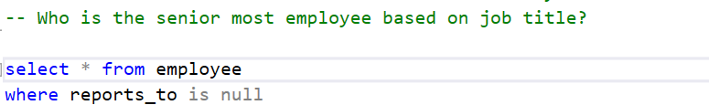
Que no 1:

Slide 6
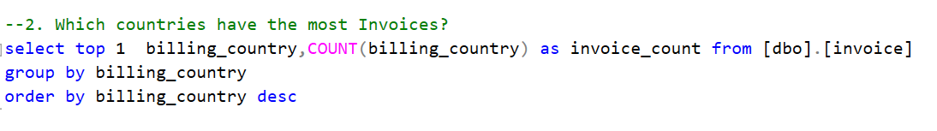
Que No 2:

Slide 7
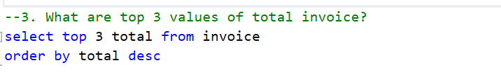
Que no 3:

Slide 8
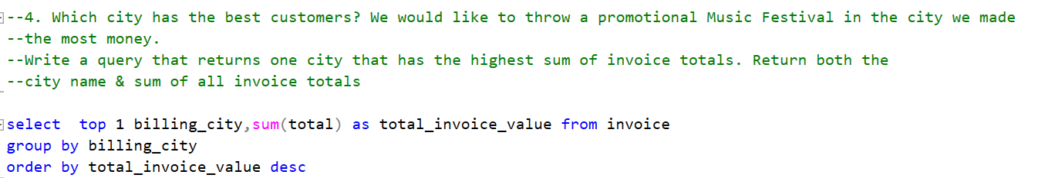
Que no4:

Slide 9
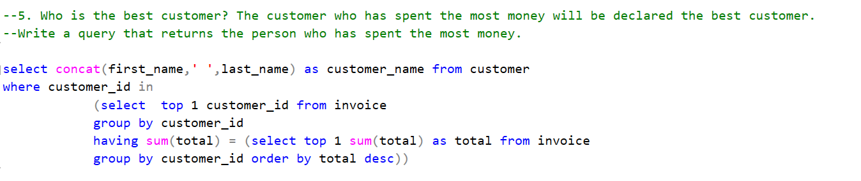
Que no 5:

Slide 10
Moderate
Using CTEs and Multiple Joins

Slide 11
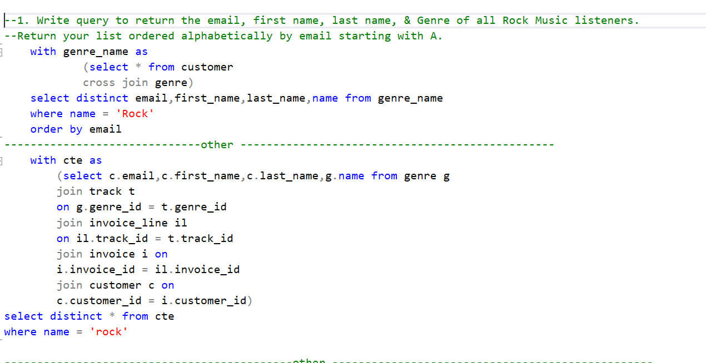
Que no 1:

Slide 12
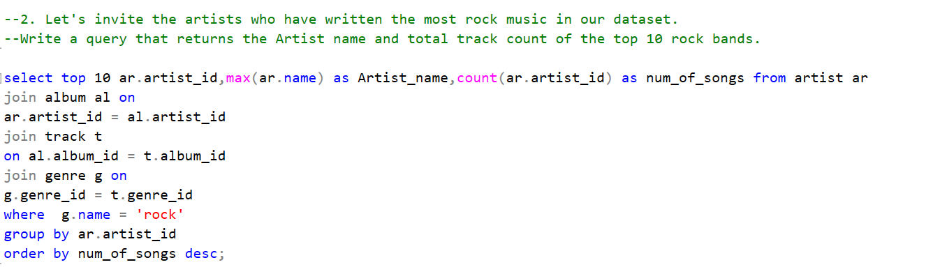
Que no 2:

Slide 13
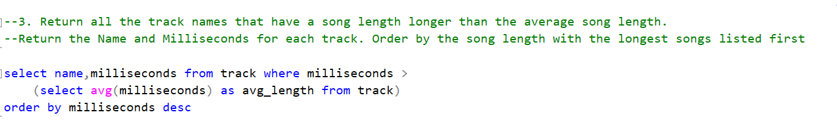
Que no3:

Slide 14
Advanced
Complex Queries and joins

Slide 15
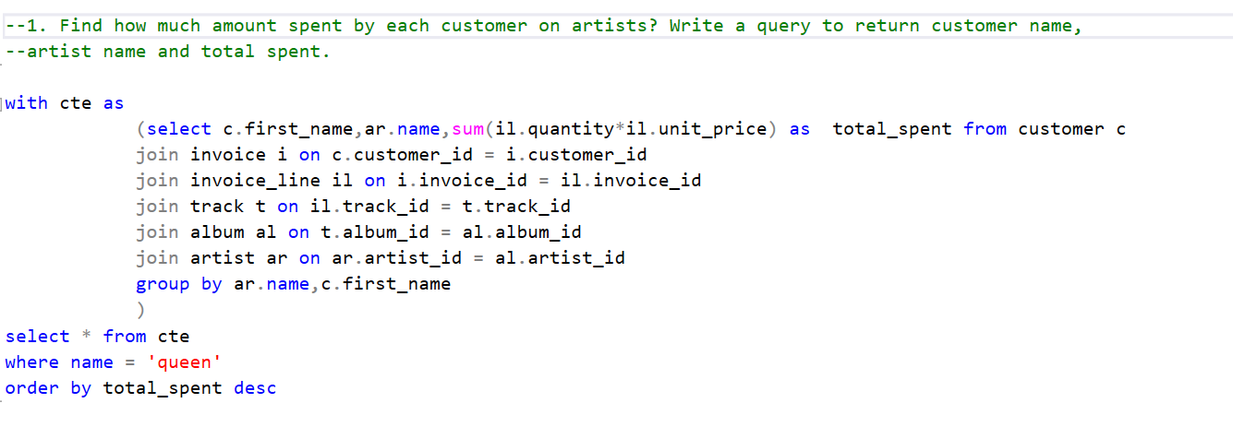
Que no1:

Slide 16
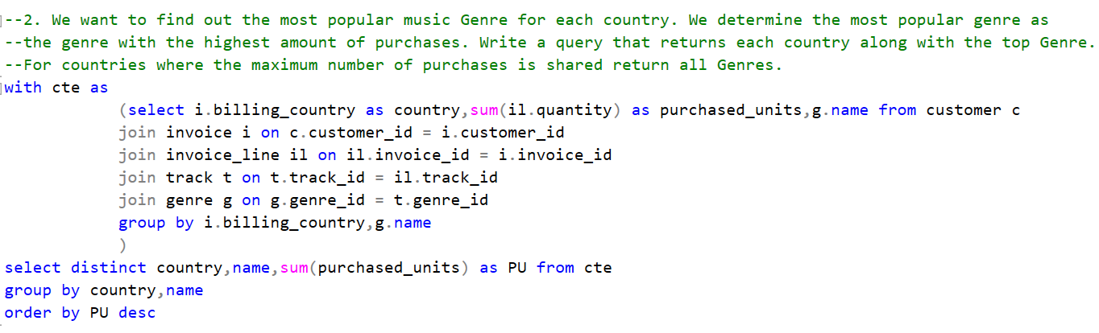
Que no2:

Slide 17
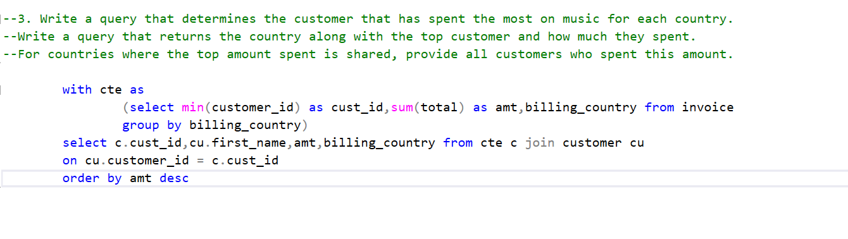
Que no3:

Slide 18
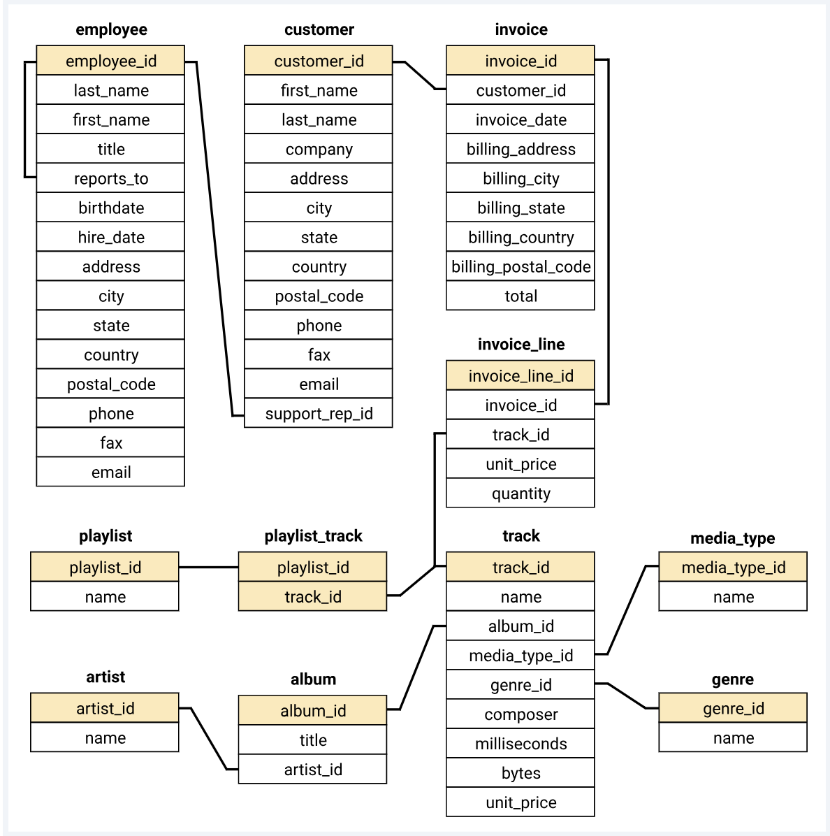
Schema

Slide 19

Thank you
Suyash Pandey

